Slide 1
Global PSP Project for Indian Embassies and Consulates
Quick Guide – Verification Officer (VO) Users’ Application

Slide 2
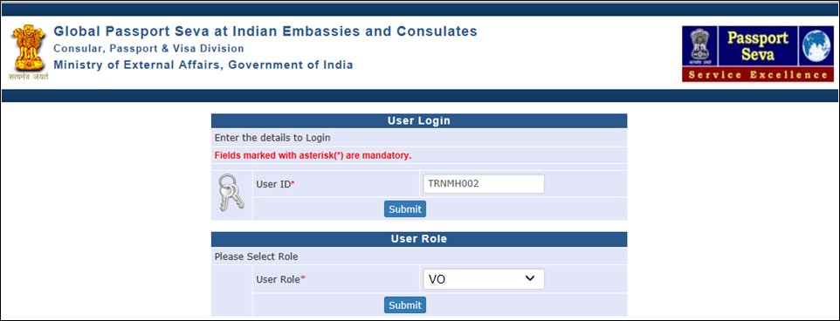
Login Using User ID, Password, and Grid Values
Visit Global PSP Office Portal (https://embassy.passportindia.gov.in)
Enter User ID
Press Submit button
Choose User Role as ‘VO’
Press Submit button displayed below the User Role

Slide 3
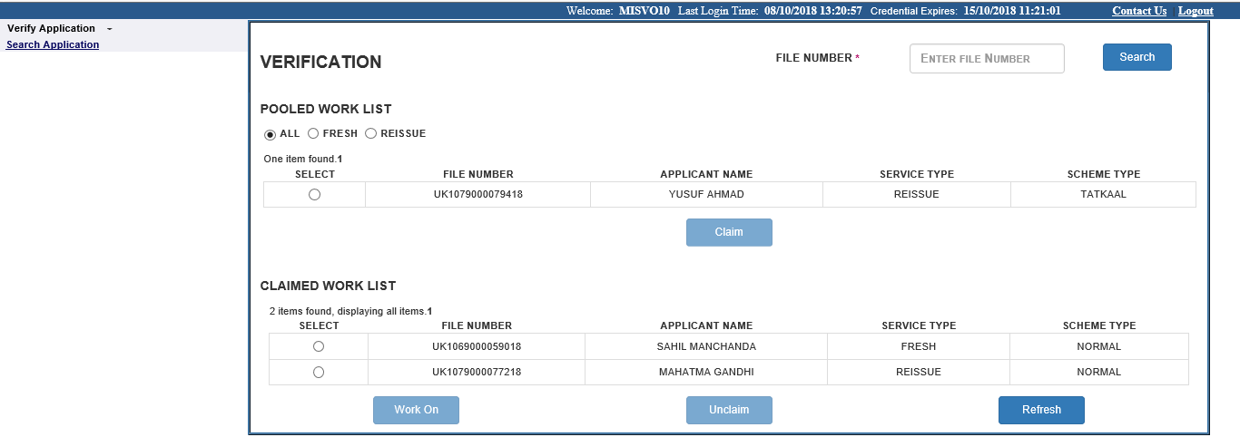
Verify Application screen
Verify Application screen displays the Pooled and Claimed Work-items’ list.
Items displayed in Pooled Work list can be claimed for processing by any VO user in the respective Mission/Post (visible to all VO users).
Items displayed in Claimed Worklist can be processed by the logged in VO user only (not visible to other VO users)

Slide 4
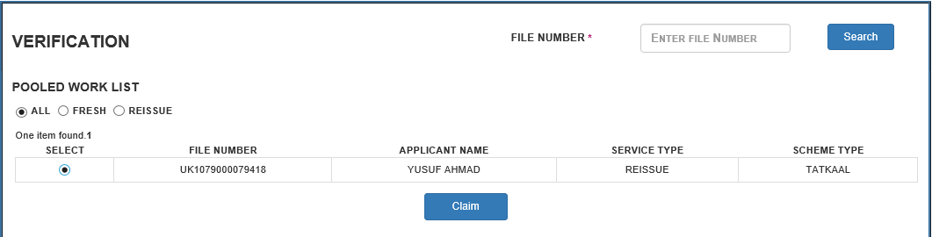
Verify Application screen (continued..)
1. Select a file in the Pooled or Claimed worklist by clicking the radio button under 'Select' column.
2. Click on the Claim button.

Slide 5
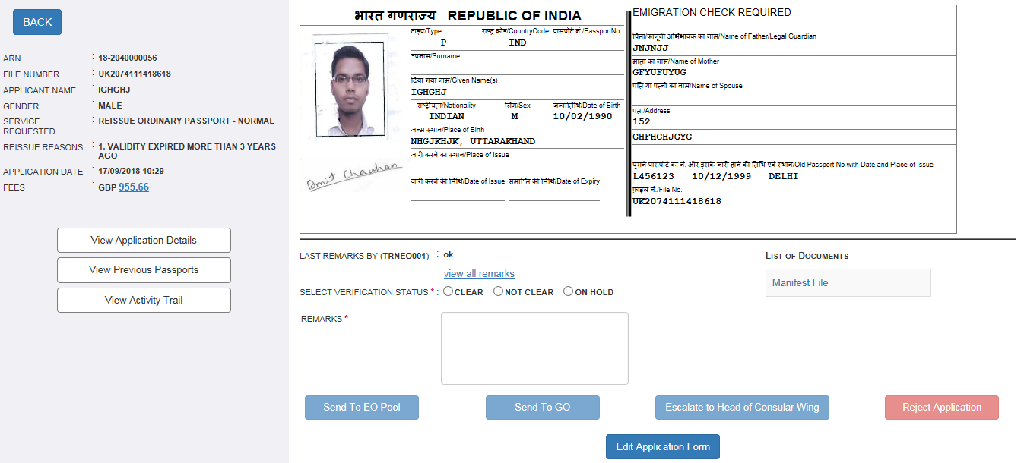
Verify Application screen (continued..)
Application details for the selected file will appear after pressing the Claim button in worklist screen.
Passport Print Preview for the selected application is displayed up-front. Separate buttons for viewing the details of previous passport and that of current application/activity trails are displayed on screen.

Slide 6
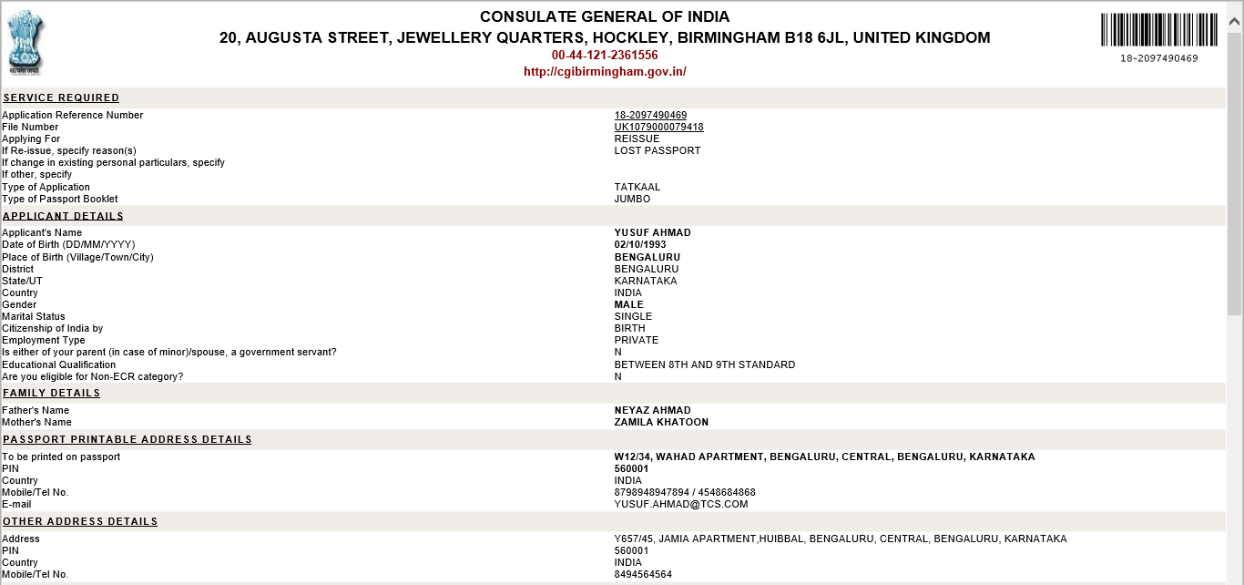
View Application Details sub-screen
This sub-screen opens when View Application Details button is clicked in the Verify Application (work-on mode) screen
All application form fields are visible in this screen

Slide 7
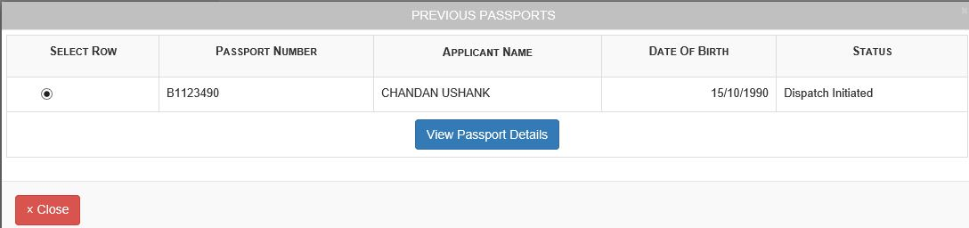
Previous Passports sub-screen
This sub-screen opens when View Previous Passports button is clicked in the Verify Application (work-on mode) screen
List of previous as well as all past passports linked with the application is displayed in chronological order of issuance

Slide 8
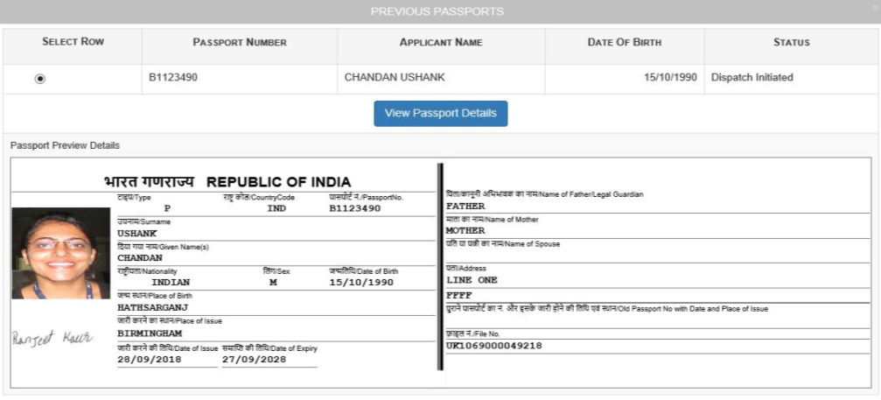
Previous Passports sub-screen (continued..)
Select the desired previous passport record by clicking the radio button displayed under Select Row column and click on the View Passport Details button to view the Passport Preview Details sub-screen.

Slide 9
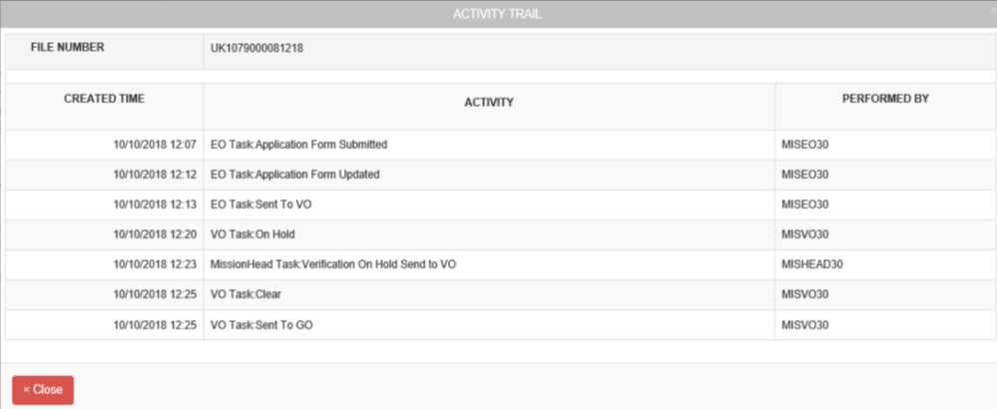
View Activity Trail sub-screen
This sub-screen opens when View Activity Trail button is clicked in the Verify Application (work-on mode) screen
The screen displays the chronological list of EO-VO-GO-Mission Head processing activities carried so far for the selected application

Slide 10
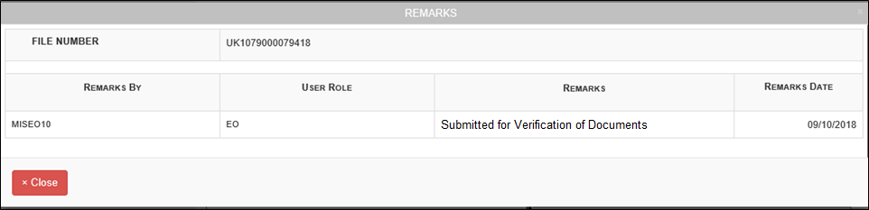
View All Remarks sub-screen
This sub-screen opens when View All Remarks button is clicked in the Verify Application (work-on mode) screen
The screen displays the chronological list of application processing remarks entered so far for the selected application by various roles’ users who acted on the application

Slide 11

Verify Application screen (continued..)
Separate buttons are provisioned in the Verify Application (work-on mode) screen to execute the following actions on the application:
Edit Application – to make changes in the data
Reject Application – to reject the application and stop further processing
Send Back to Enrolment Officer for correction in data/documents
Escalate to Head of Consular (Role: MissionHead)
Send to Granting Officer – to confirm successful verification of documents

Slide 12
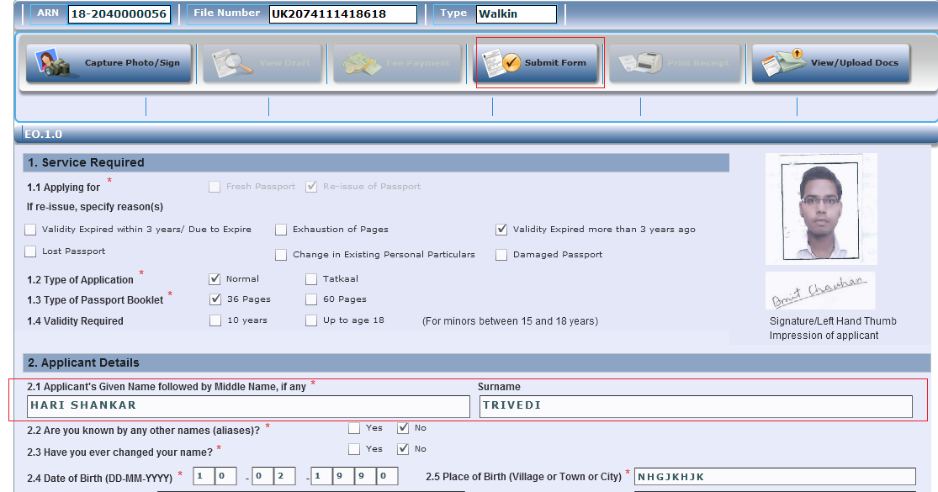
1. Verify Application → Edit Application Form screen
Click on Edit Application Form button on Verify Application screen
Click on Edit Form button to enable the Application Form for editing
After editing required details, click on he Submit Form button to save the changes

Slide 13
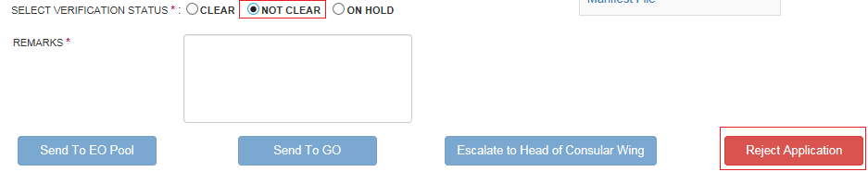
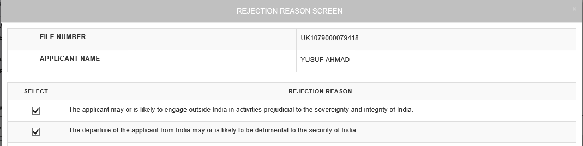
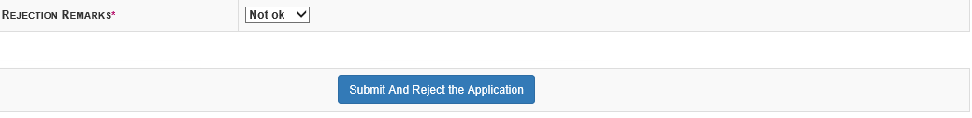
2. Verify Application → Reject Application screen
Select Verification Status to 'Not Clear' on Verify Application screen
Enter Remarks and Click on Reject Application button.
Select the Rejection Reason and Rejection Remarks.
Click on Submit to complete rejection of the application.

Slide 14
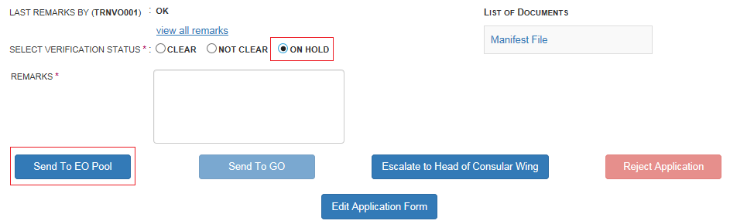
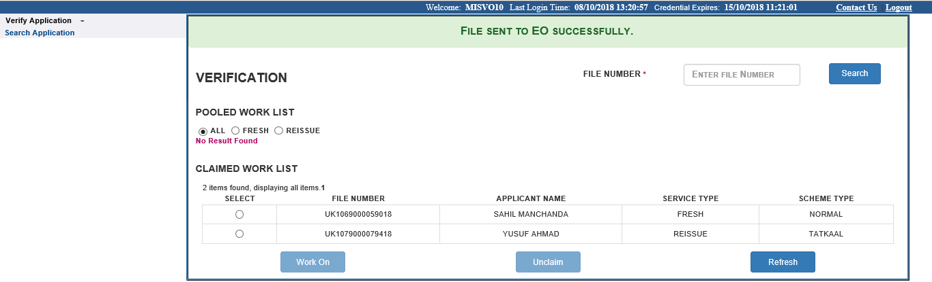
3. Verify Application → Send Back file to Enrolment Officer (EO)
Select Verification Status to 'On Hold' on Verify Application screen
Enter Remarks and Click on 'Send to EO Pool' button. The file will start reflecting in EO role users’ Pooled worklist

Slide 15
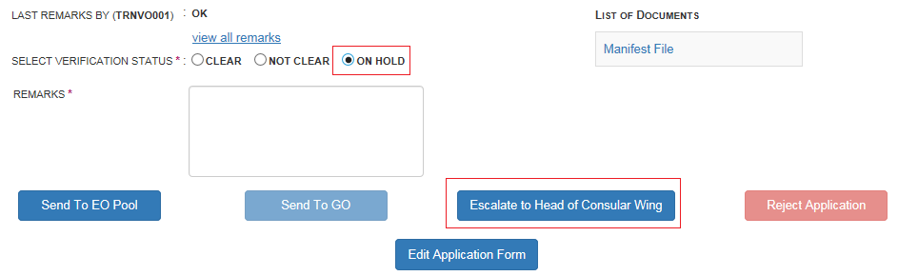
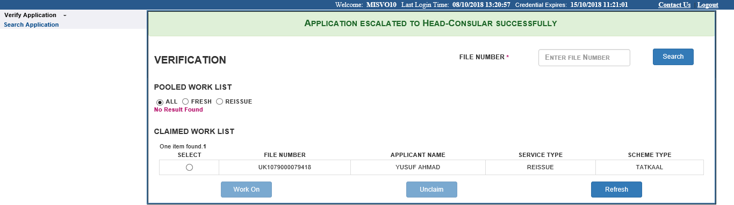
4. Verify Application → Escalate to Head of Consular Wing
Select Verification Status to 'On Hold' in Verify Application screen
Enter Remarks and click on 'Escalate to Head of Consular Wing' Button.
Select the Escalation Reason and click on 'Submit and Escalate to Head-Consular' Button.

Slide 16
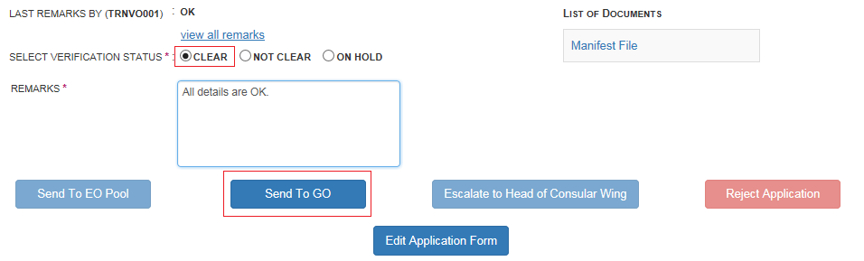
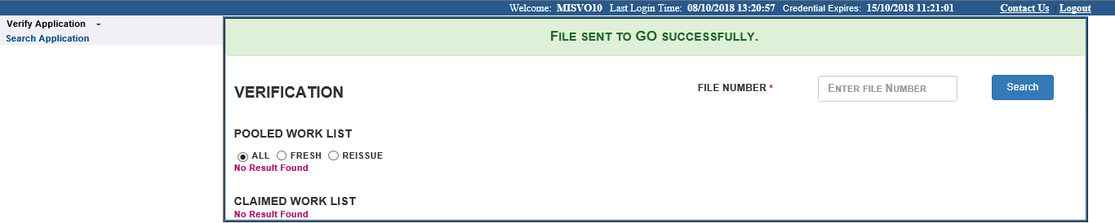
4. Verify Application → Send to Granting Officer
Select Verification Status to 'Clear' .
Enter Remarks and Click on 'Send To GO' Button.

Slide 17
In case of additional information or clarification, please contact Global PSP Support Team at
Email : global.psp@tcs.com
Phone: +91-0120-672-9595/96
Mobile: +91-730-351-9595
Thank You

